Slide 1

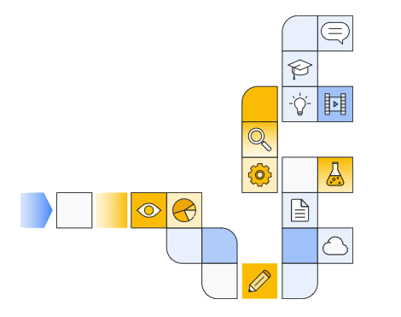

Google cloud generative ai overview Part 1
Notes:
https://www.cloudskillsboost.google/paths/118/course_templates/388

Slide 2
Overview
Notes:
https://www.youtube.com/watch?v=lSI38D7Gxhc&t=1s

Slide 3
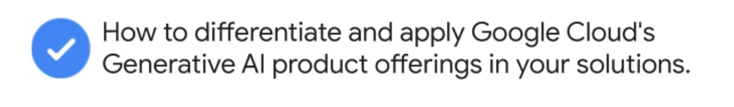
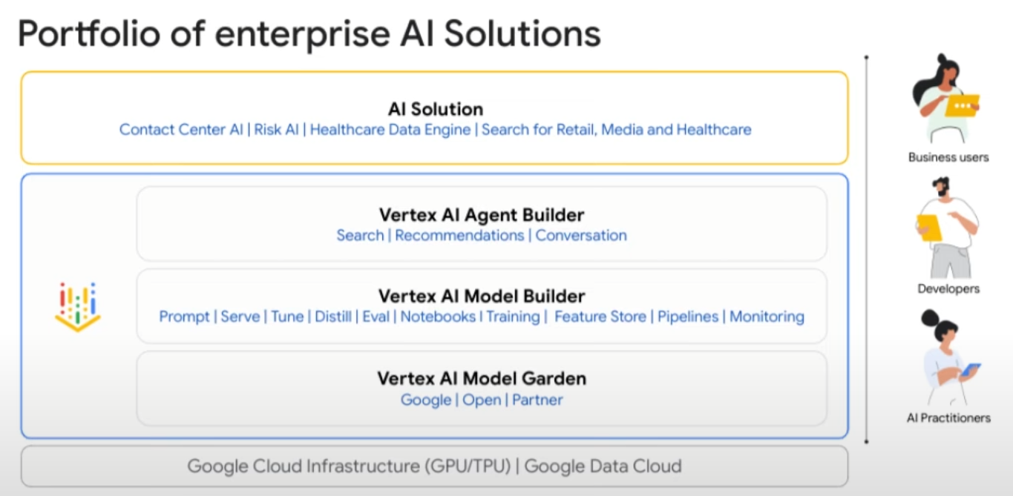

Slide 4
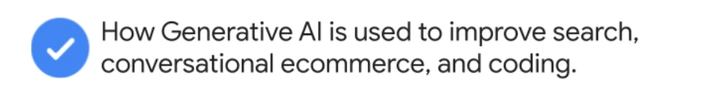
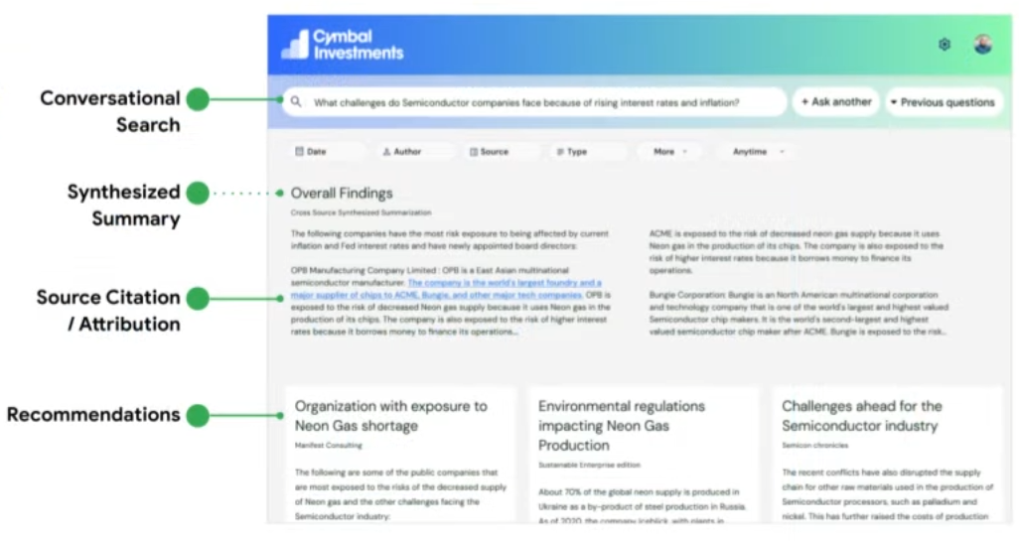

Slide 5
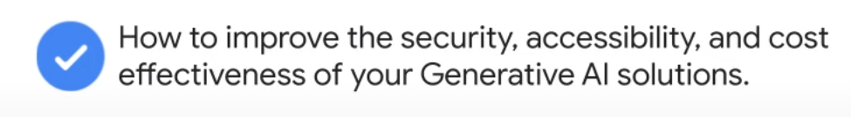
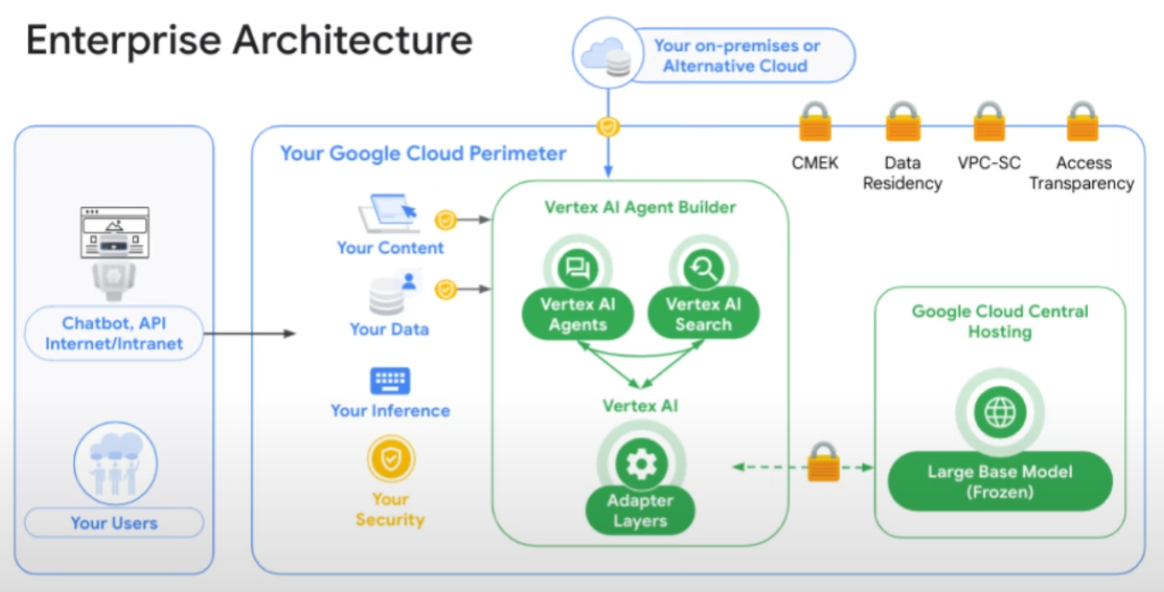

Slide 6

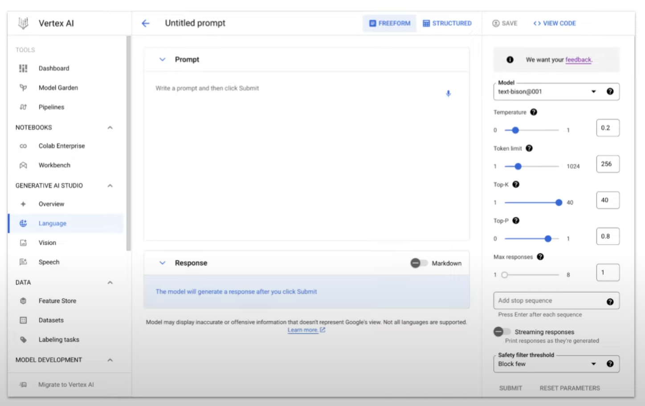

Slide 7
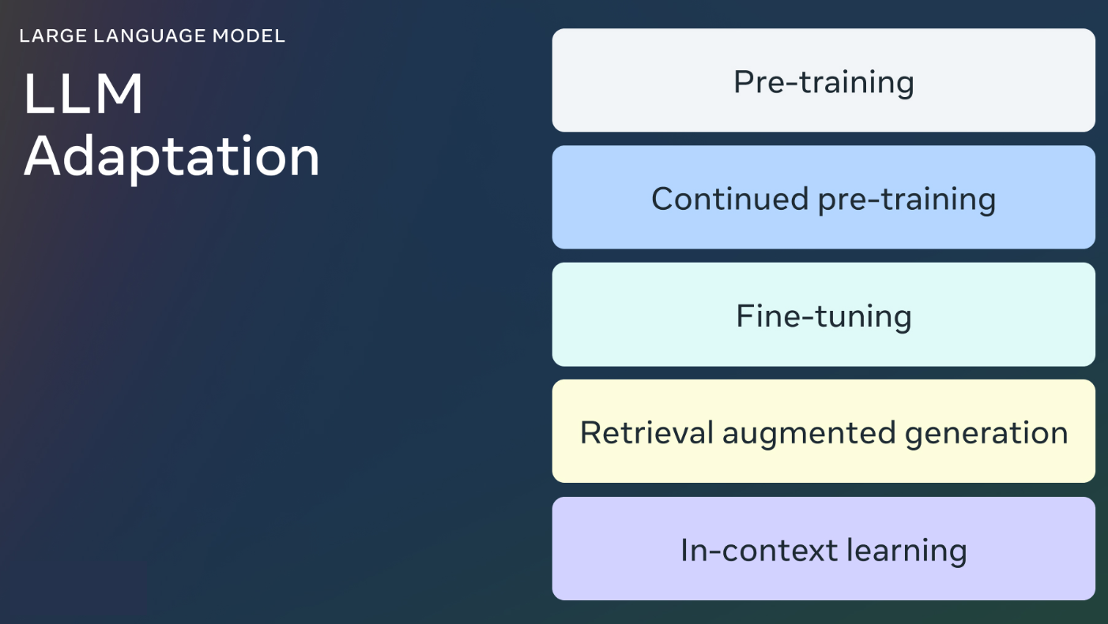

Slide 8
Ai at google
Notes:
https://www.youtube.com/watch?v=iPAYaUPYDag&t=1s

Slide 9
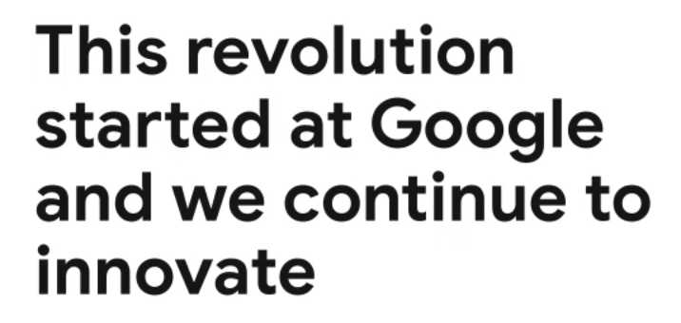
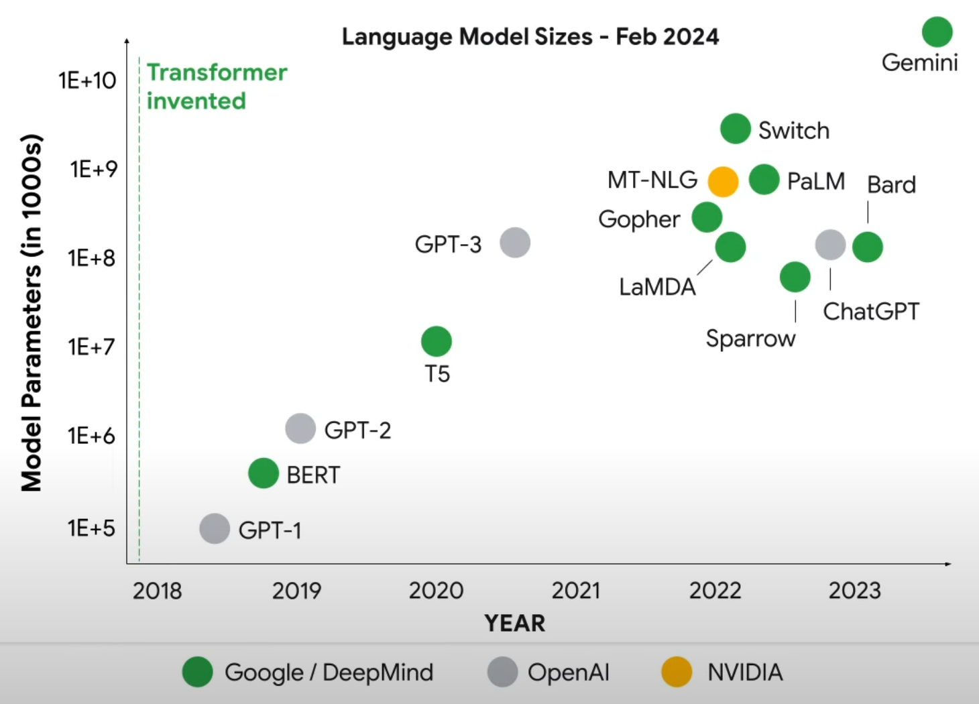

Slide 10
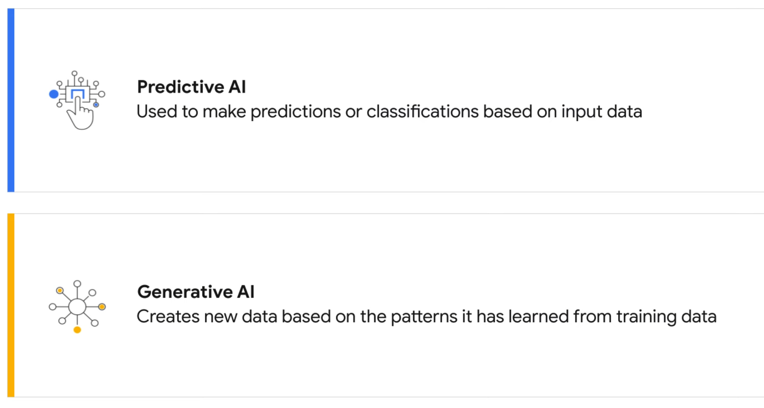

Slide 11
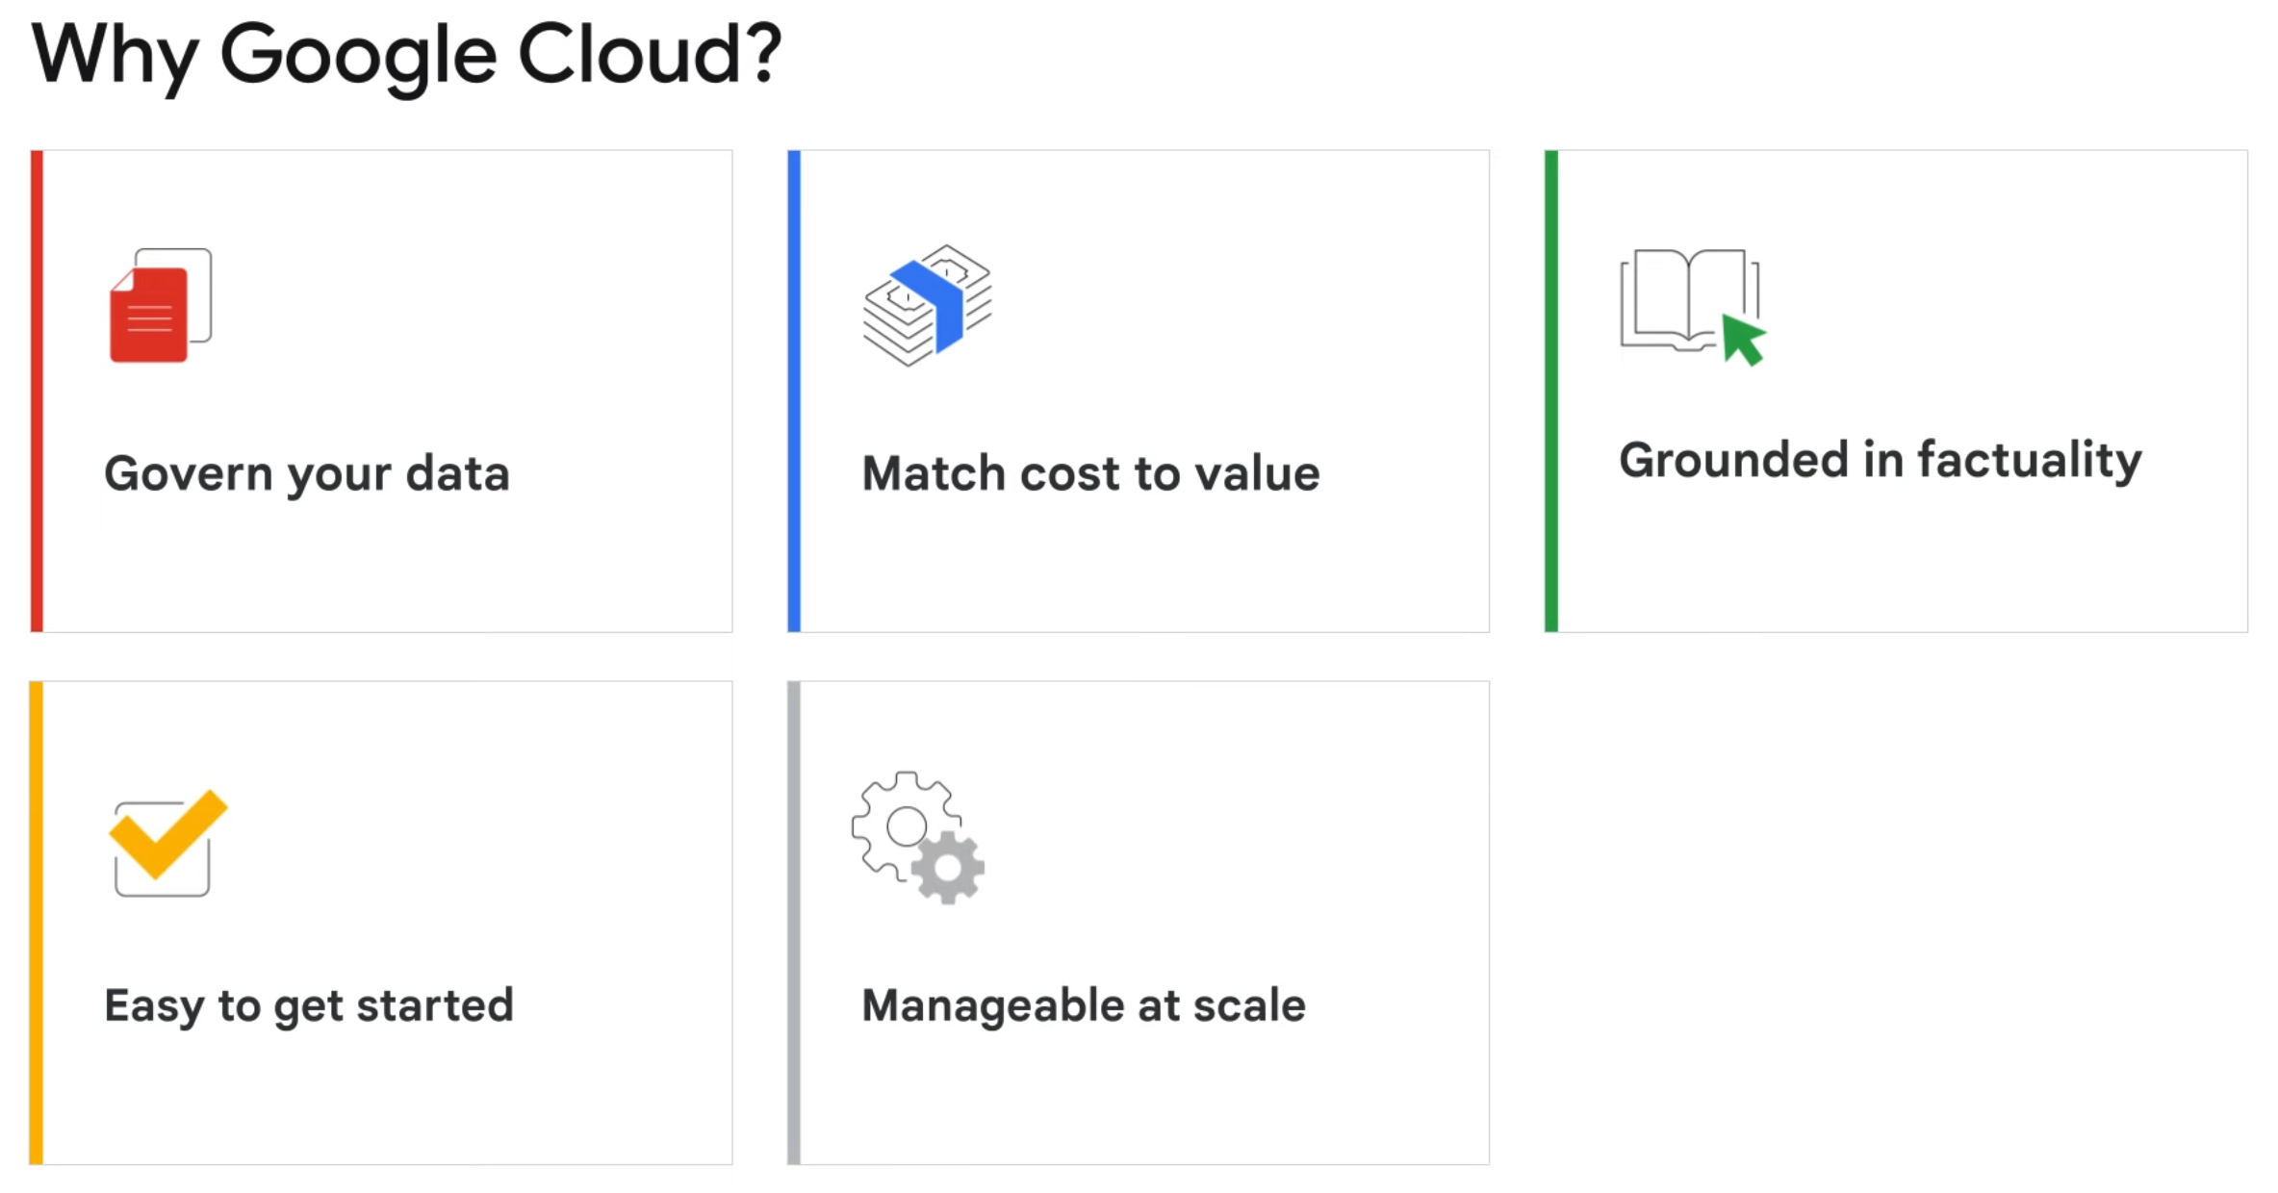

Slide 12
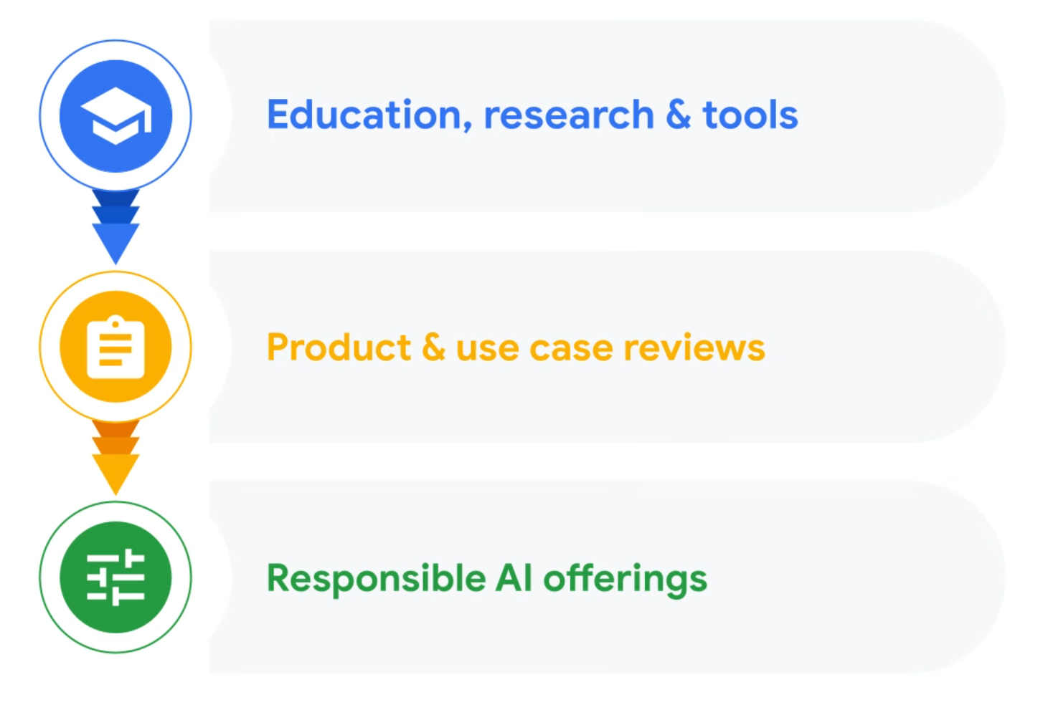
Notes:
Approach to responsible AI

Slide 13
Google cloud Generative ai building blocks
Notes:
https://www.youtube.com/watch?v=yKrx4S_FrNo&t=2s

Slide 14
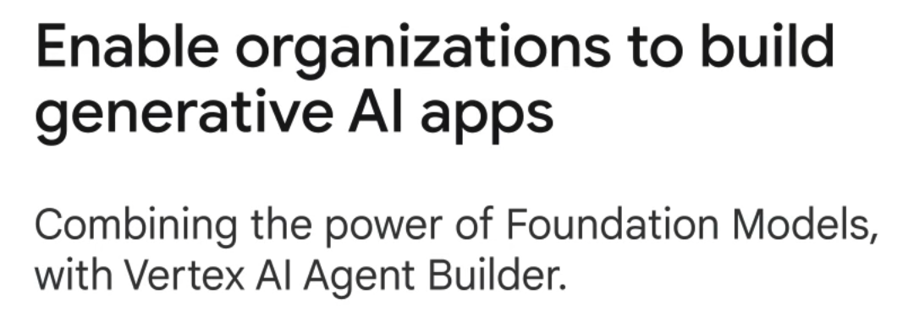
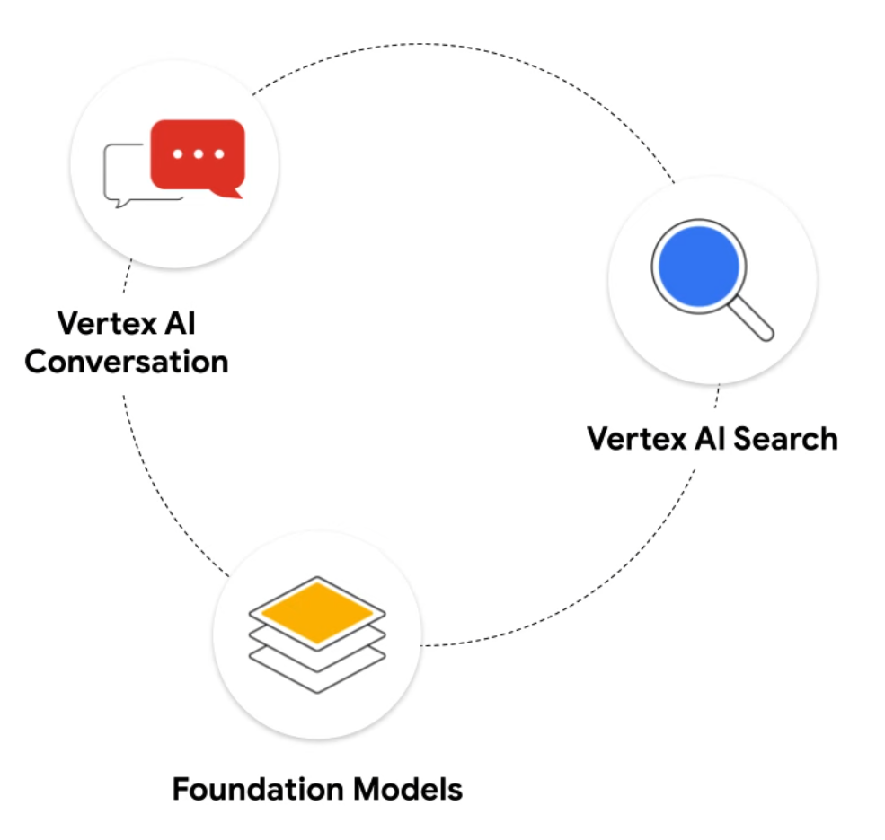

Slide 15
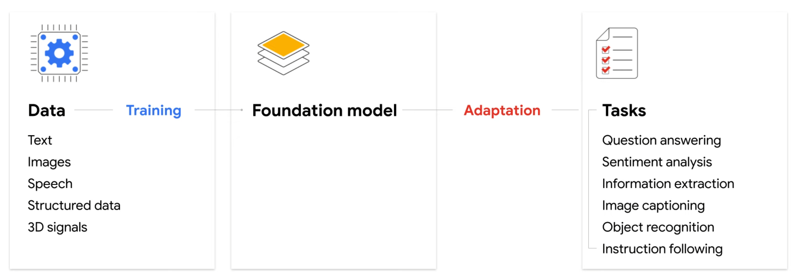

Slide 16

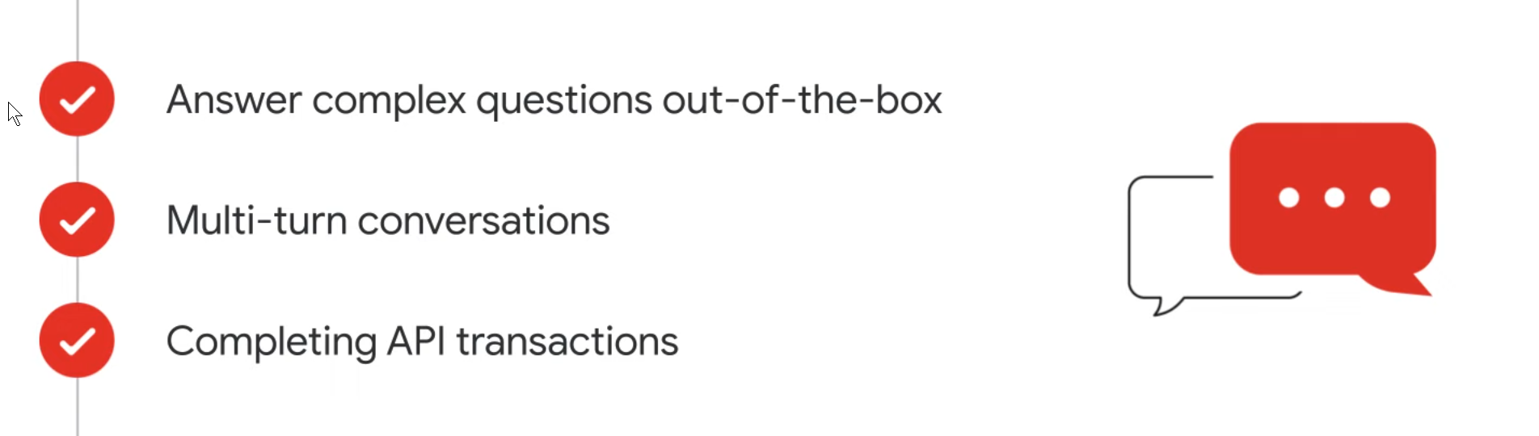

Slide 17

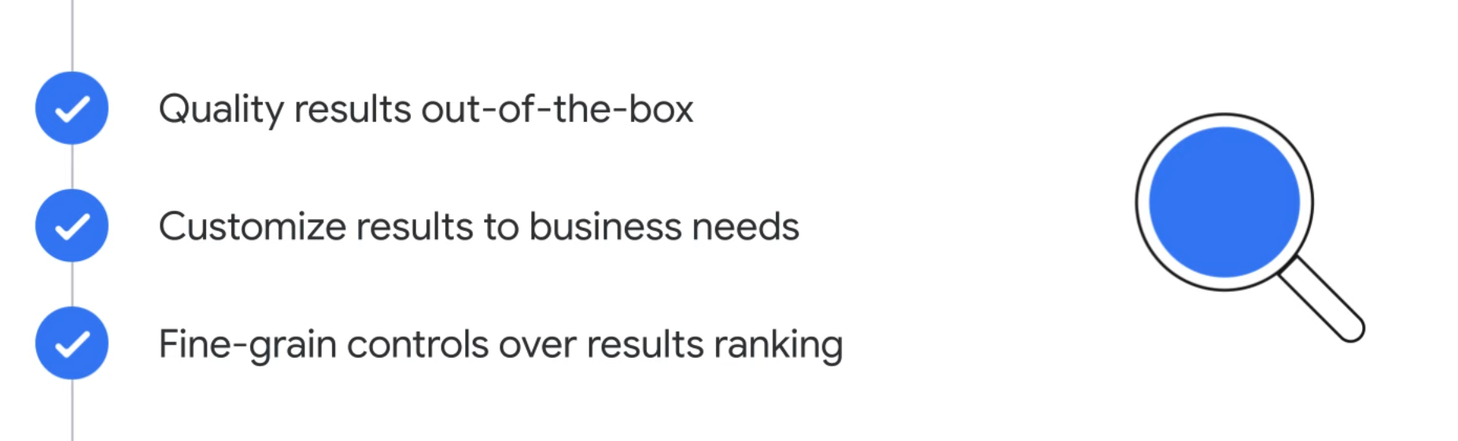

Slide 18

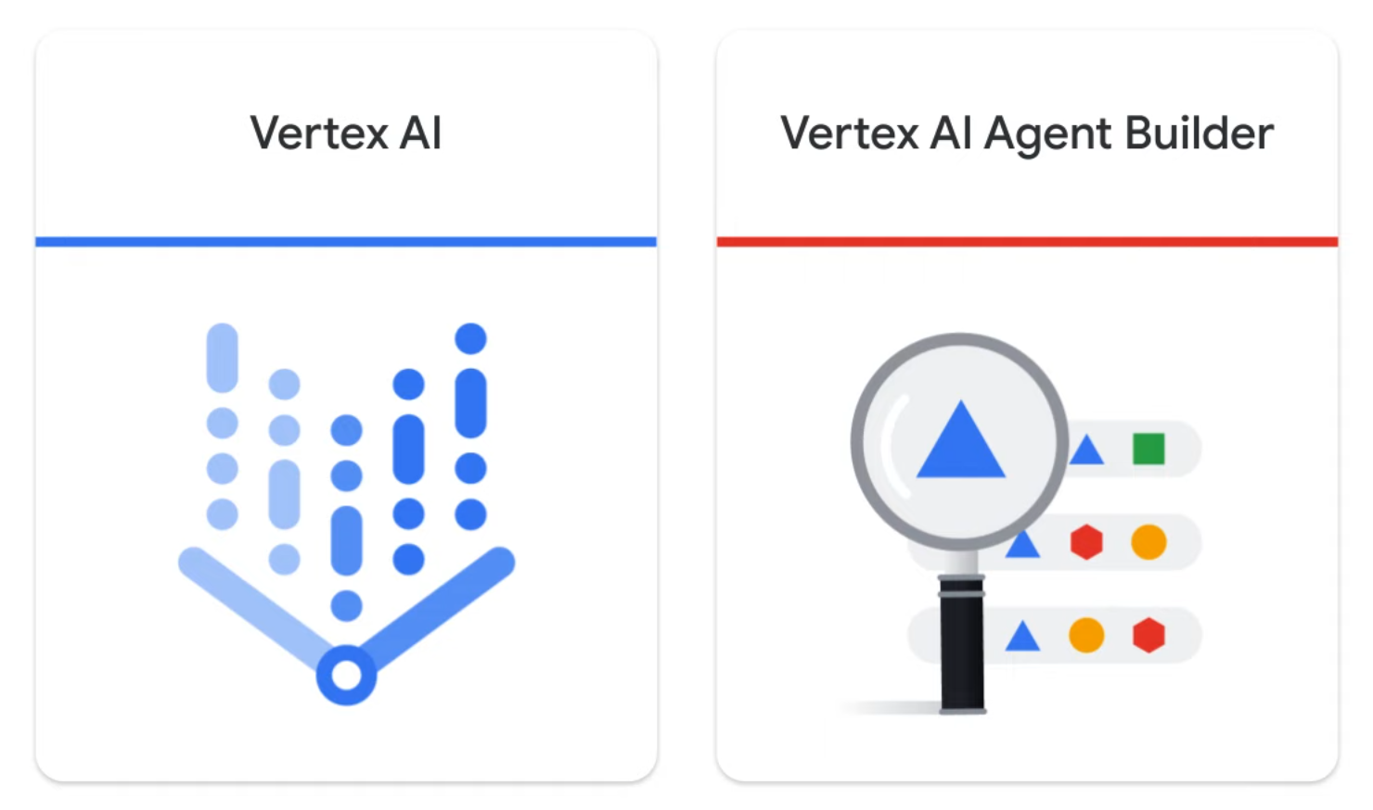

Slide 19
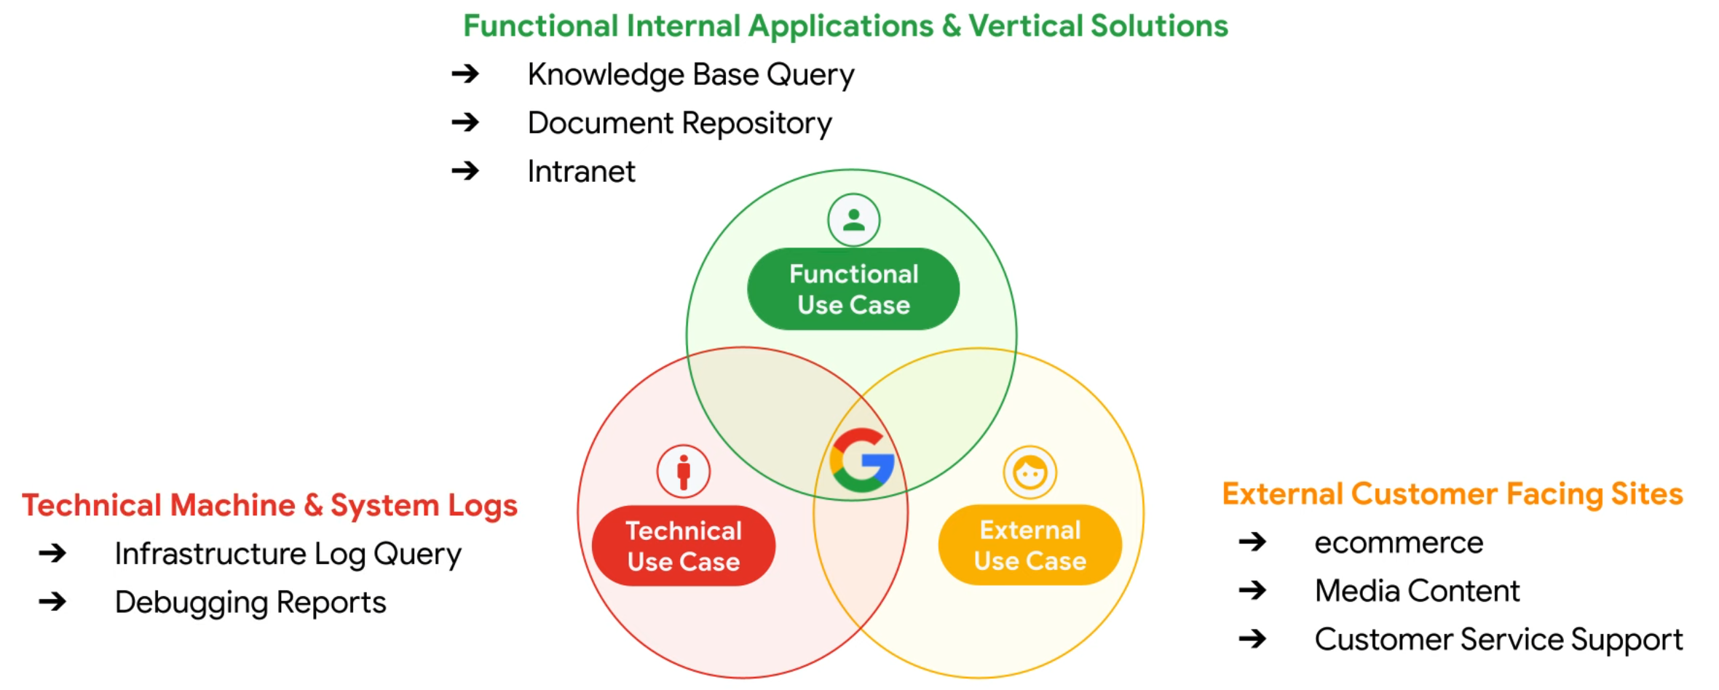

Slide 20


